Slide 1


CycleGANs
Presented by
Anshika, Niegil , Vishnu and Sakthisree

Slide 2


Content
Introduction
Theory
Mathematical Formulation
Results
Conclusion

Slide 3
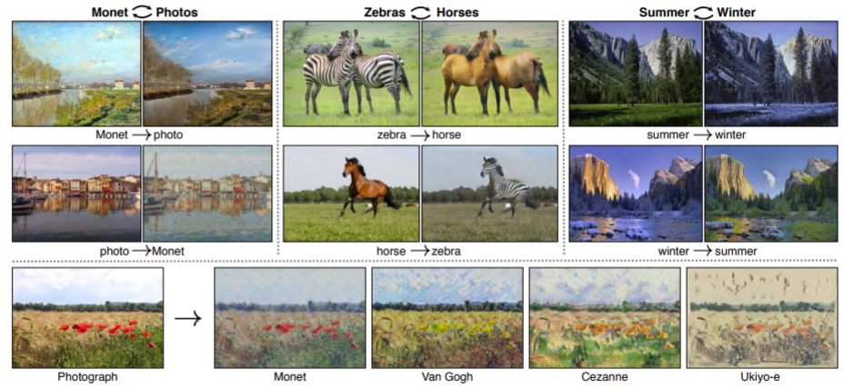
Introduction
Generative Adversarial Networks (GANs) are used in creating datasets
CycleGANs convert an image from one domain to another eg: converting a horse to a zebra, an apple to a orange, etc
CycleGANs do not need a one to one mapping of images from the input to the target domain.

Slide 4
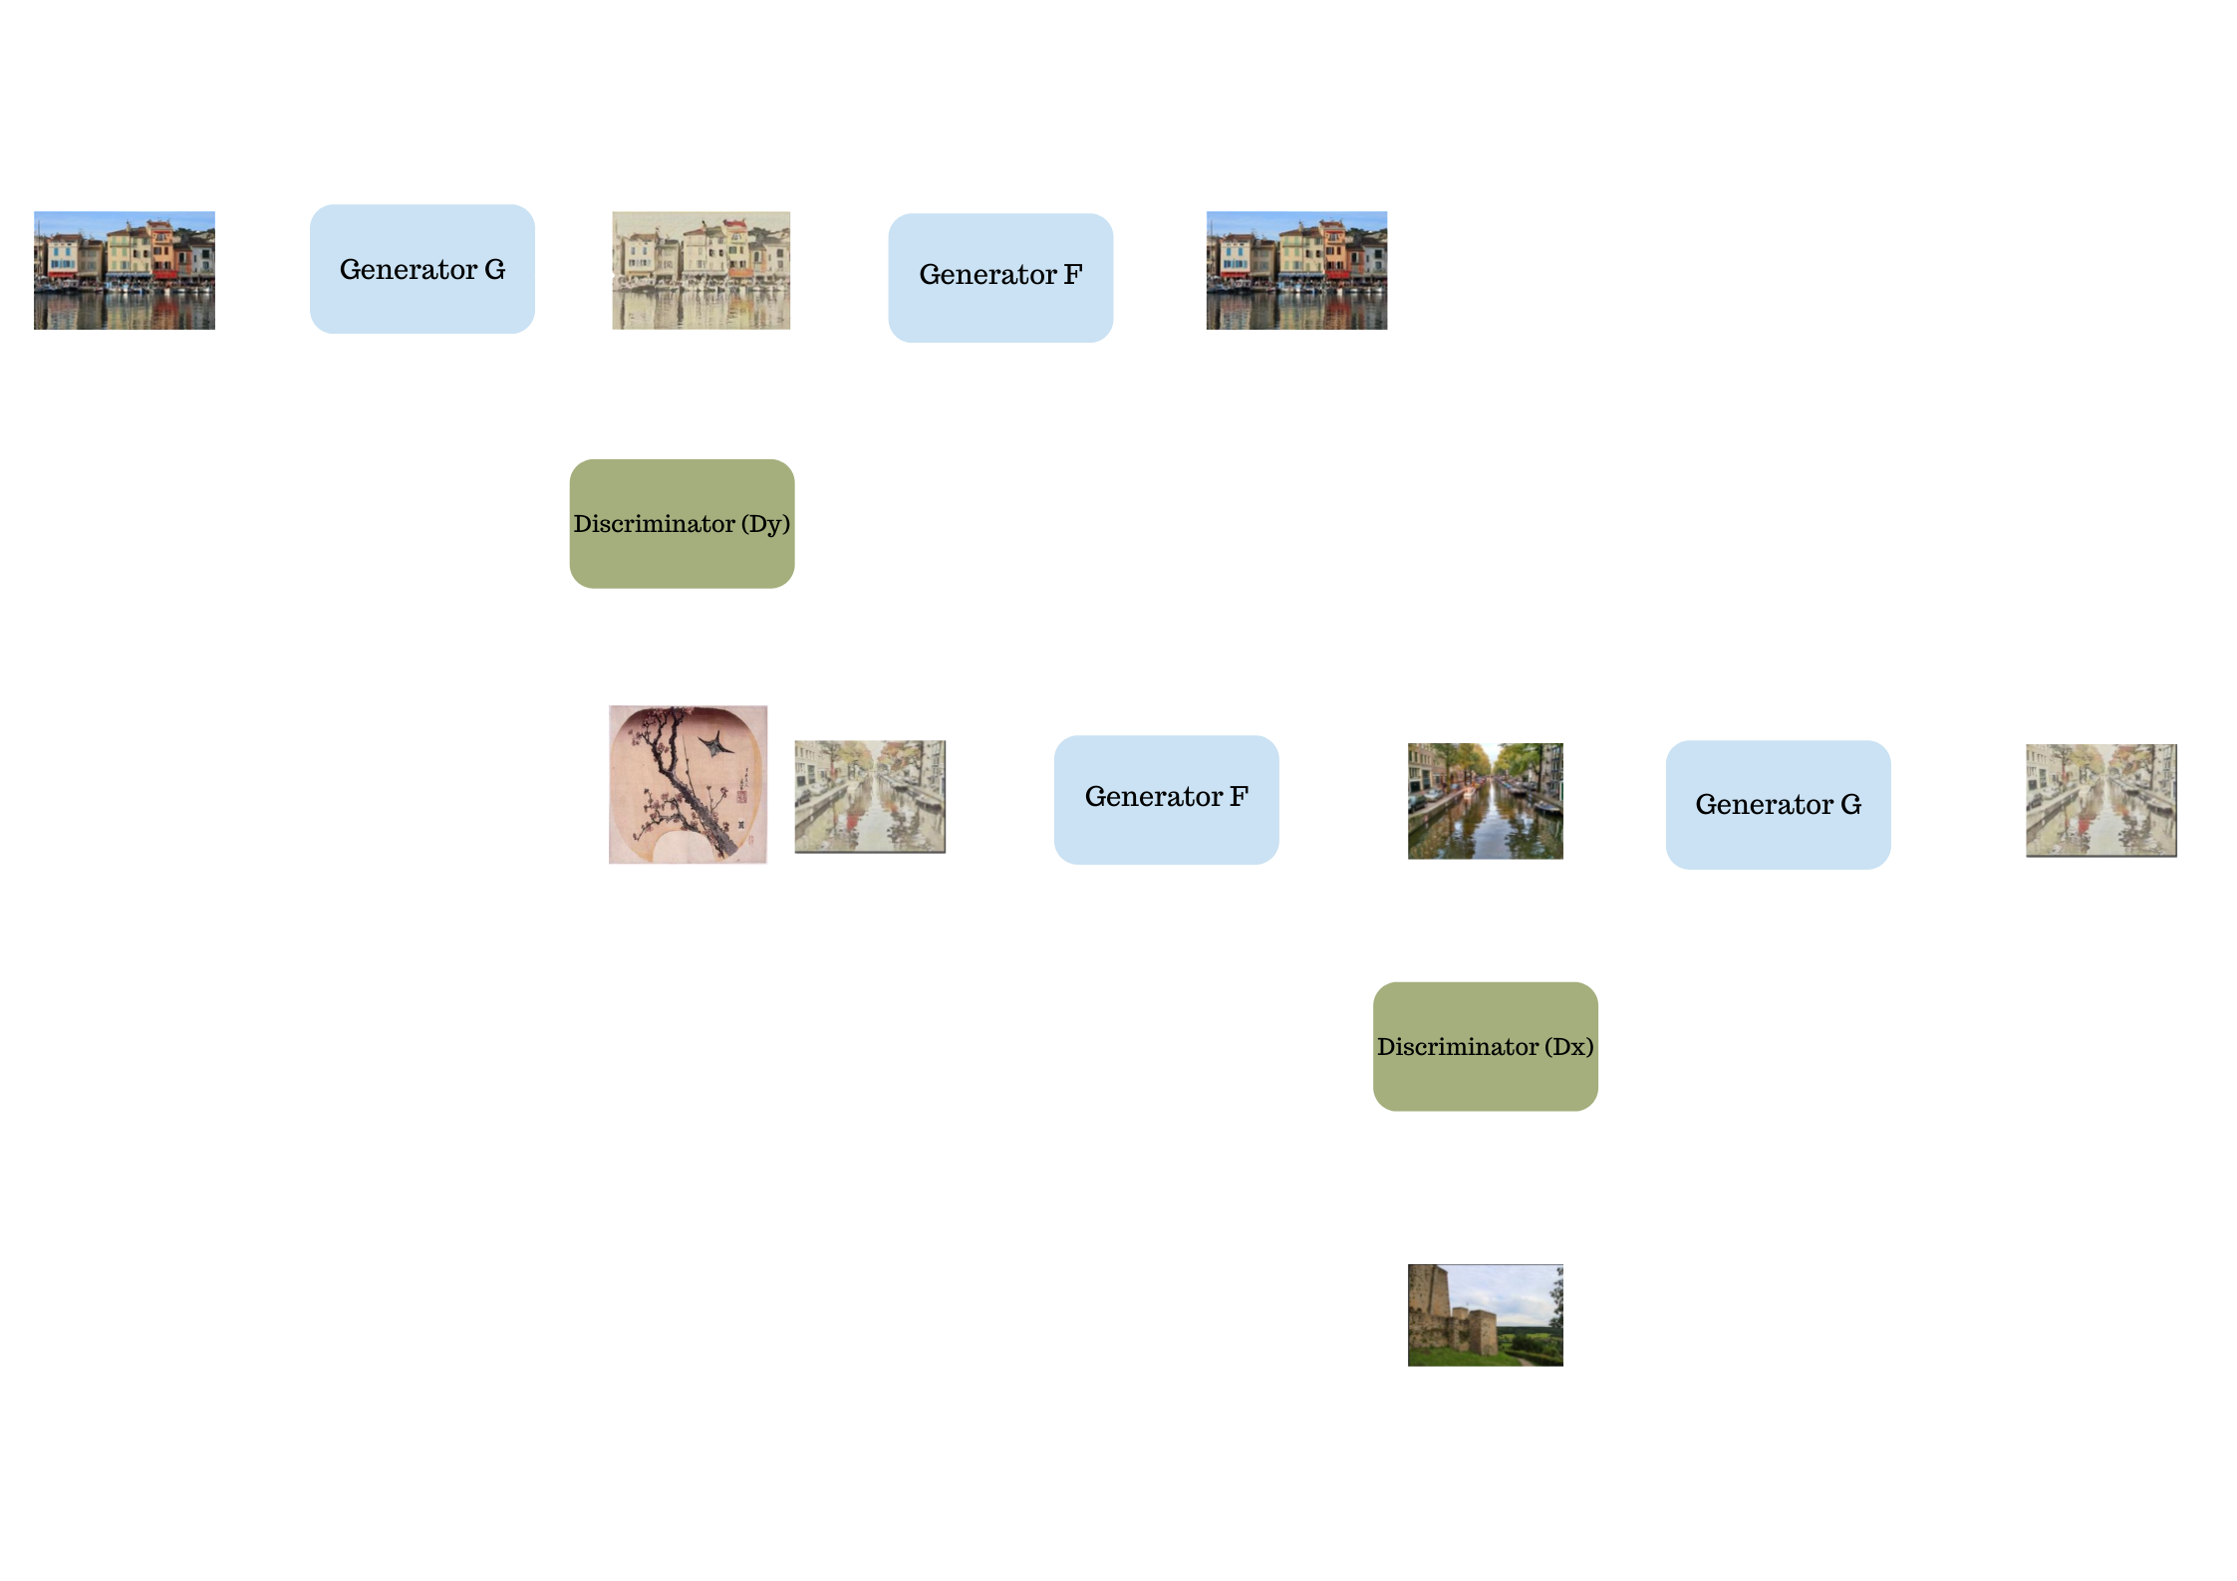
Theory
CycleGANs architecture
Four generators
A generator G that converts an input image in domain A to a fake image in the target domain B.
A generator F that converts this fake image in domain B back to domain A.
The reverse operation takes an image from domain B and generator F generates a fake image in domain A.
This fake image in domain B is converted back to domain A using generator F.
There are two discriminators with two inputs each.
A fake image generated by either F or G
A real image from the corresponding domain of the fake image

Slide 5
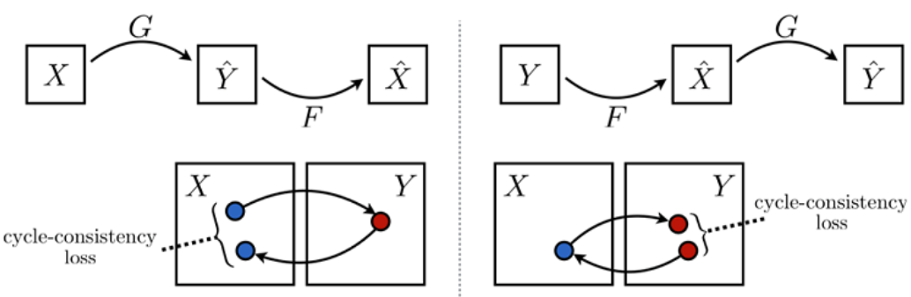
Theory
Cycle consistency loss : L1 loss between the input image and the reconstructed image.
There is also an adversarial loss associated with the output of the discriminator [0,1].
This leads to four loss functions (two per conversion to a domain) that are summed up to get the objective function.

Slide 6
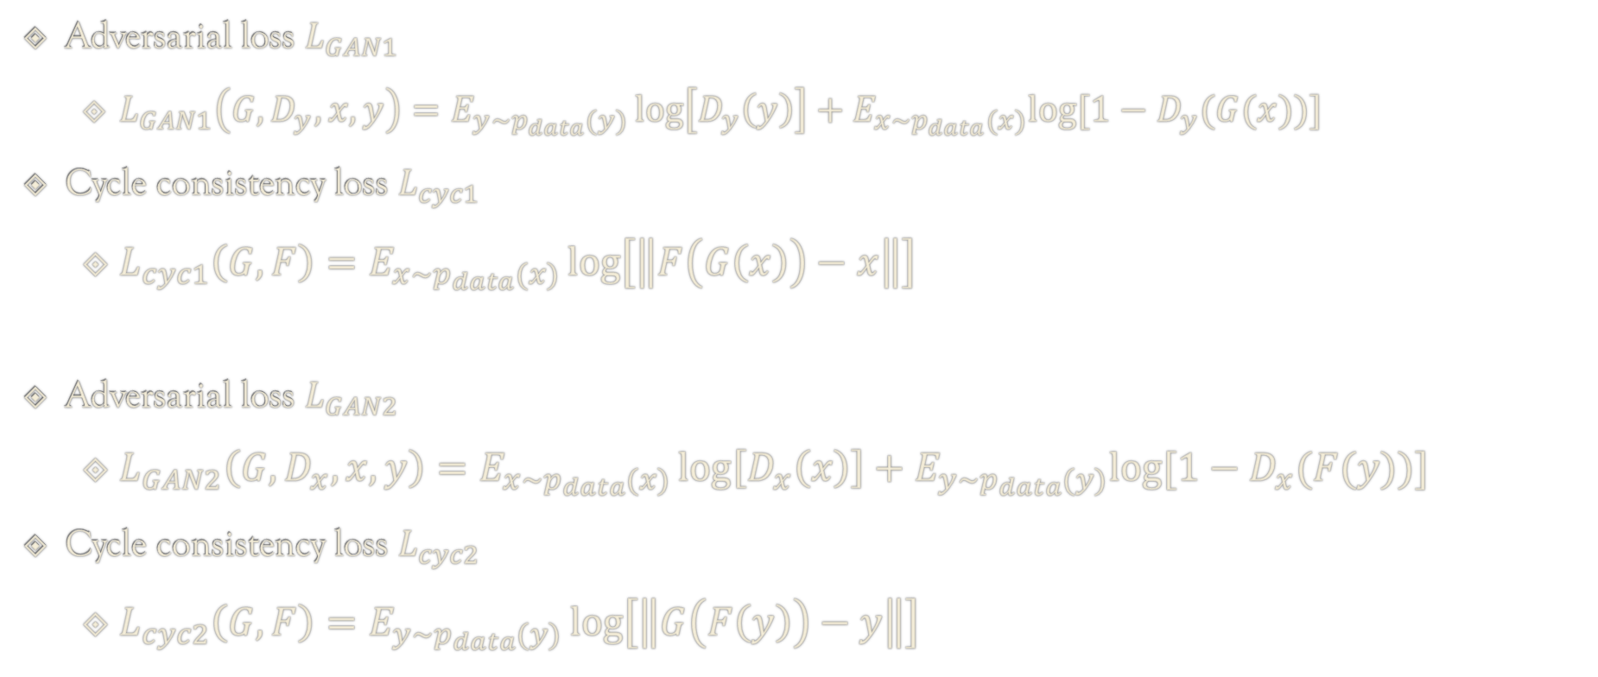
Mathematical Formulation
Adversarial loss $L_{GAN1}$
$L_{GAN1}\left(G,D_{y},x,y\right)=E_{y\sim p_{data}(y)}\log\left[D_{y}\left(y\right)\right]+E_{x\sim p_{data}(x)}log⁡[{1−D}_{y}(G(x))]$
Cycle consistency loss $L_{cyc1}$
$L_{cyc1}\left(G, F\right)=E_{x\sim p_{data}(x)}\log\left[\left\|F\left(G\left(x\right)\right)−x\right\|\right]$
Adversarial loss $L_{GAN2}$
$L_{GAN2}\left(G,D_{x},x,y\right)=E_{x\sim p_{data}(x)}\log\left[D_{x}\left(x\right)\right]+E_{y\sim p_{data}(y)}log⁡[{1−D}_{x}(F(y))]$
Cycle consistency loss $L_{cyc2}$
$L_{cyc2}\left(G, F\right)=E_{y\sim p_{data}(y)}\log\left[\left\|G\left(F\left(y\right)\right)−y\right\|\right]$

Slide 7
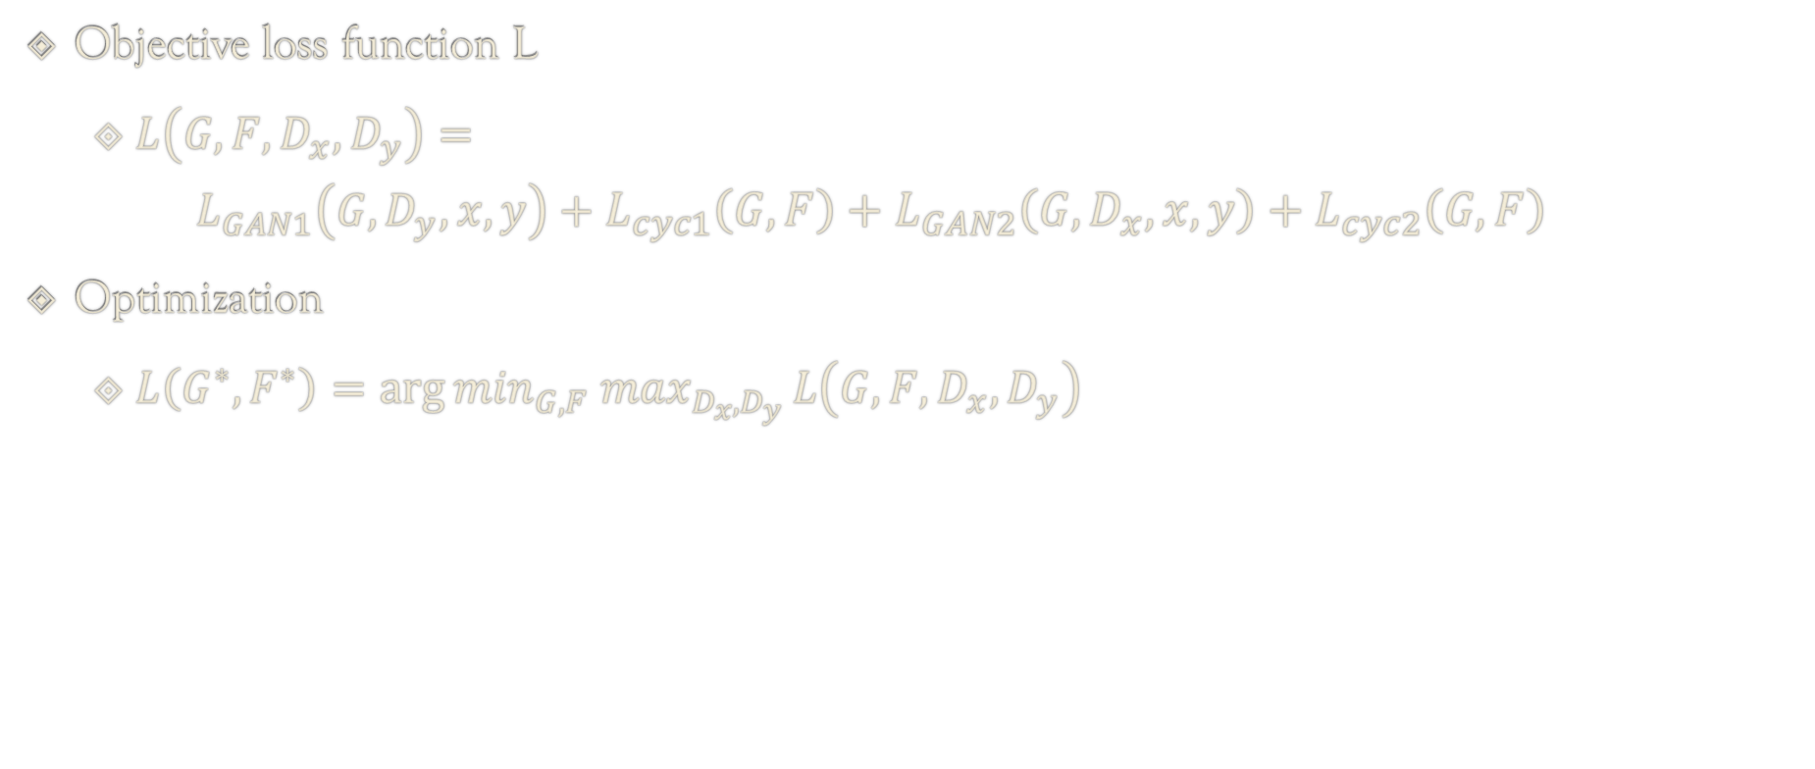
Mathematical Formulation
Objective loss function L
$L\left(G,F,D_{x},D_{y}\right)=$
$$L_{GAN1}\left(G,D_{y},x,y\right)+L_{cyc1}\left(G, F\right)+L_{GAN2}\left(G,D_{x},x,y\right)+L_{cyc2}\left(G, F\right)$$
Optimization
$L\left(G^{∗},F^{∗}\right)=\arg{\min_{G,F} \max_{D_{x},D_{y}}}L\left(G,F,D_{x},D_{y}\right)$

Slide 8
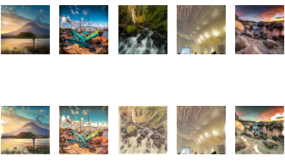
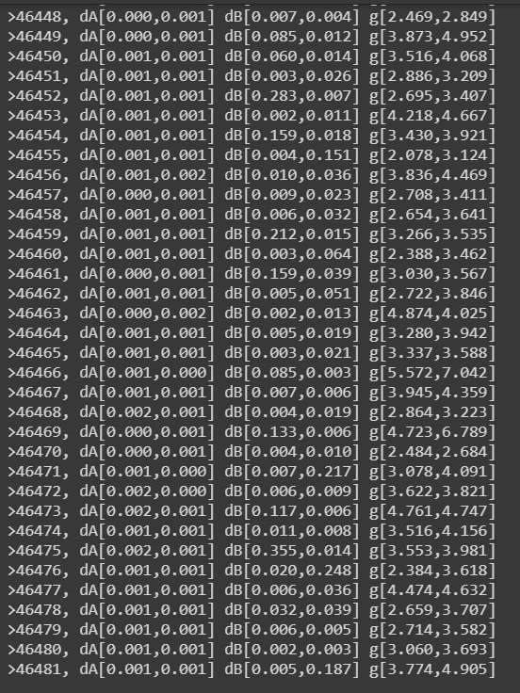
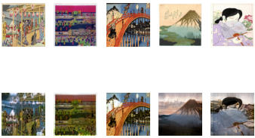
Results

Slide 9
Conclusion
We found that the model does not change the shape of object well.
The model performs well on mountains.

Slide 10
Thank you

